Slide 1
Deep Learning Training
Lecture 4: Convolutional Neural Networks

Slide 2
Content
Convolutional Neural Network (CNN)
Application
Structure
Motivation
Basic operation in CNN
Convolution
Pooling
Parameter Counting

Slide 3
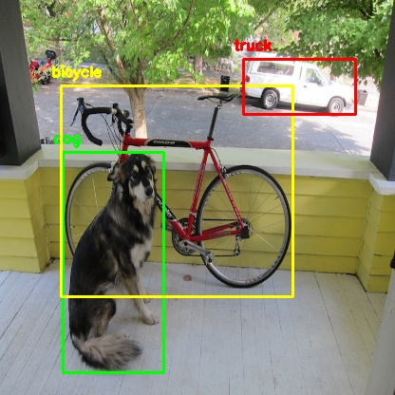
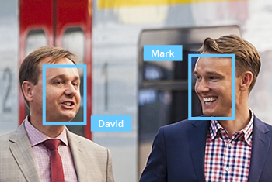
Convolutional Neural Network (CNN)
Application of CNN
CNN is mostly used in computer vision related architecture
Also it has use in audio, text processing.
Used as automatic feature extractor for image data
For example: Face detection, Style generation, Autonomous car etc.
image source[1,2]

Slide 4
Motivation Behind CNN
Motivated by structure of visual cortex of cat and monkey
Sometimes we are interested in getting some kind of representation. Convolutional layer of CNN gives better representation in some cases
CNN response gives translational invariance to the data. Which is important detecting object existence in spite of it’s different position
It takes much less parameter for same performance than MLP. So, its easier to train.

Slide 5

CNN Structure
image source[3]

Slide 6
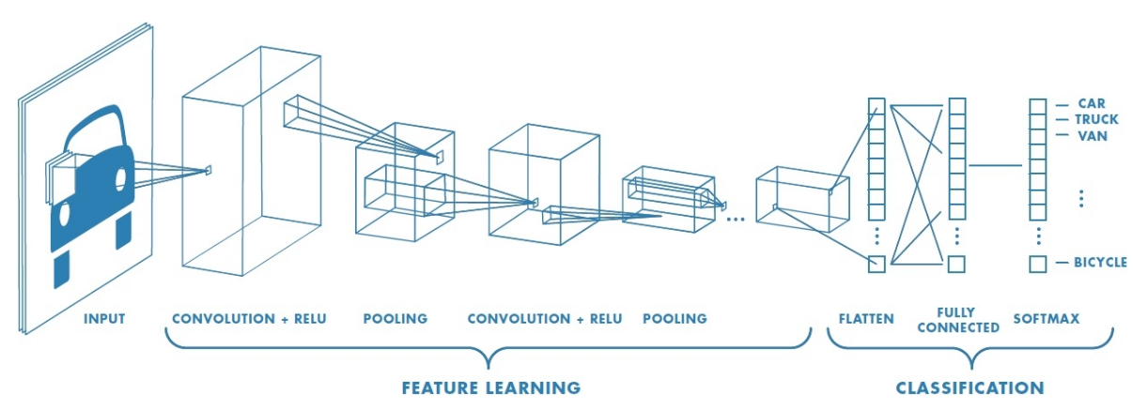
CNN Structure
image source[4]

Slide 7
Basic Operations in CNN
CNN has two operation which are unique to them
Convolution gives CNN the feature extraction capabilities
Pooling operation reduce the size of feature space

Slide 8
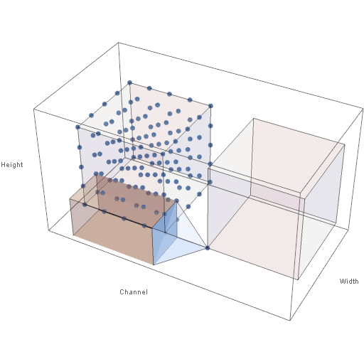
Convolution Operation
image source[5]

Slide 9
Convolution Operation
Related Terminologies :
Kernel: Kernel is the convolution matrix which is applied on multi dimensional(1-4) input to create feature map. Kernel is applied repeatedly on input cells with definite spacing.
Stride: The spacing at which kernel is applied repeatedly on input is called stride.
Padding: While applying convolution, to handle cells at the edge some extra cells with zero values are added around the input. This is called padding. Padding is characterized by the number of cells added along one dimension.

Slide 10
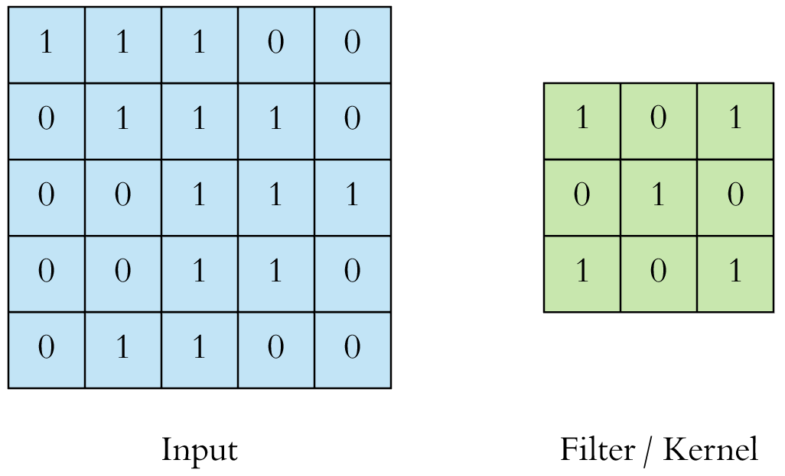
Convolution Operation
Padding = 0, stride = 1
image source[6]

Slide 11
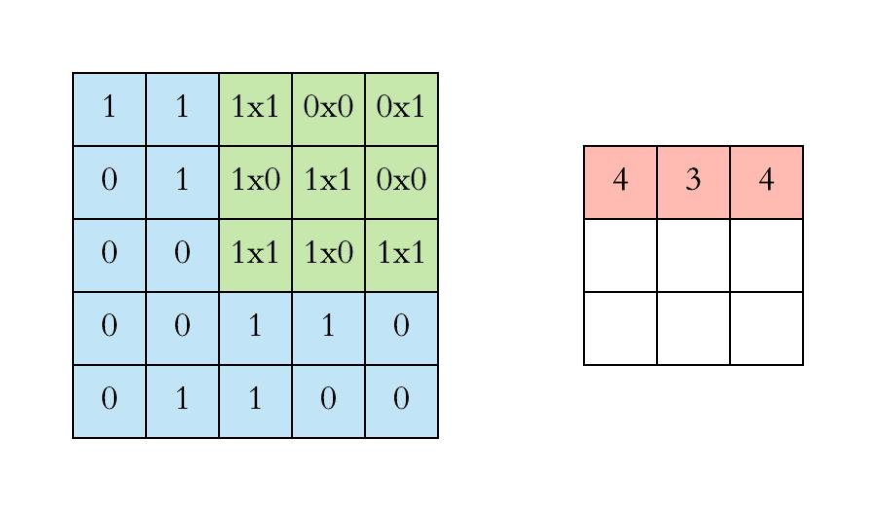
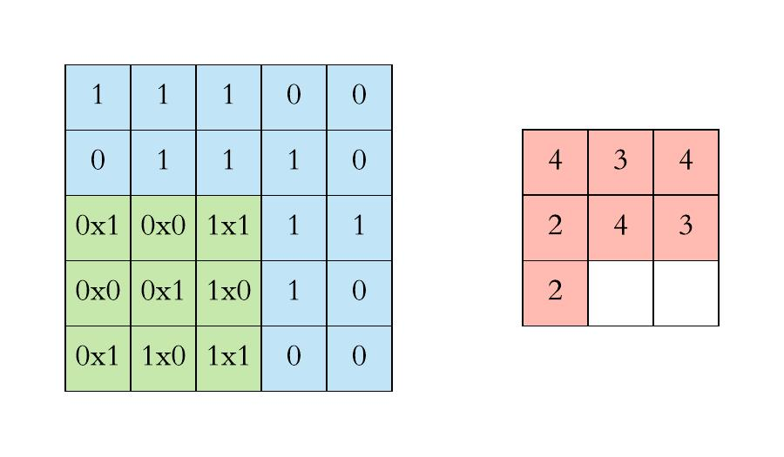
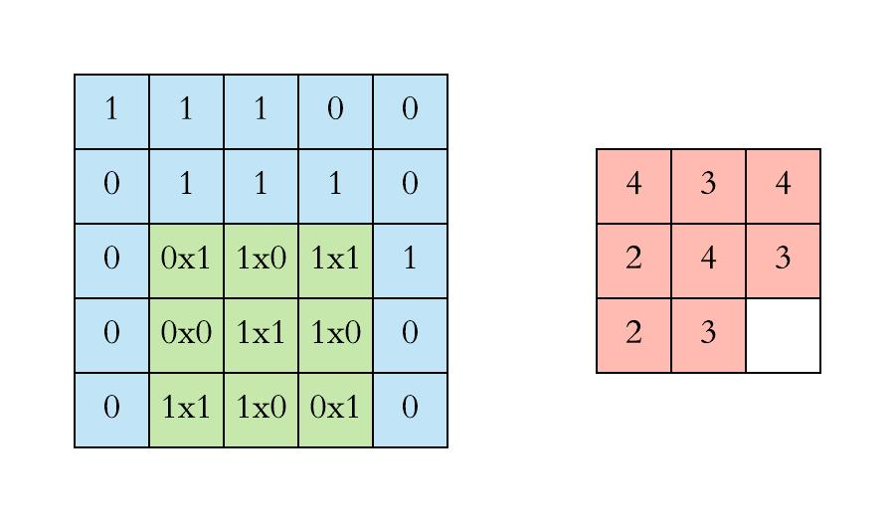
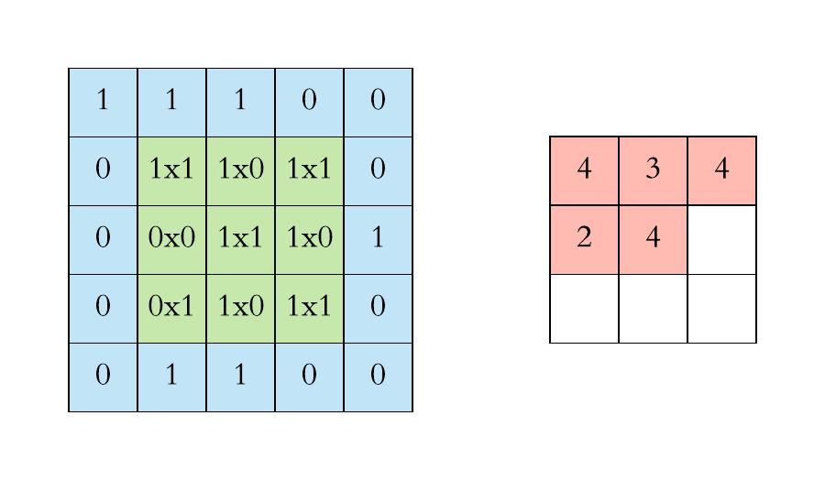
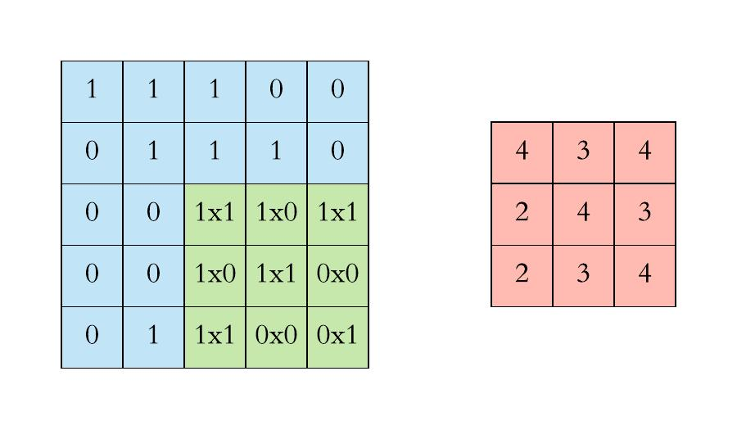
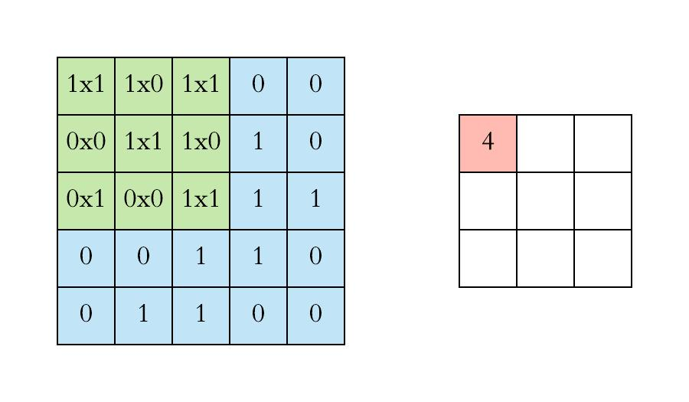
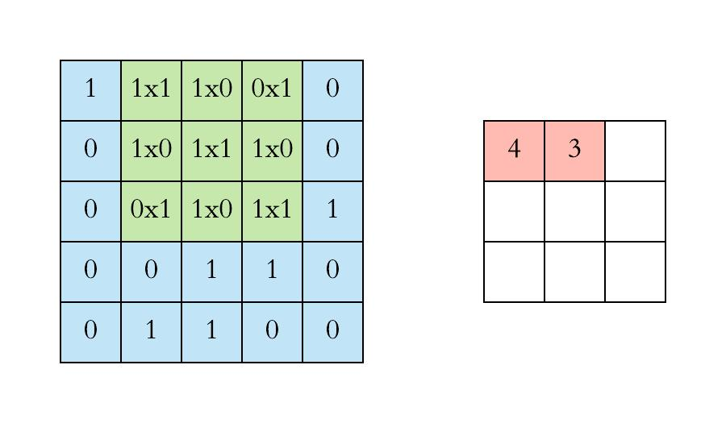
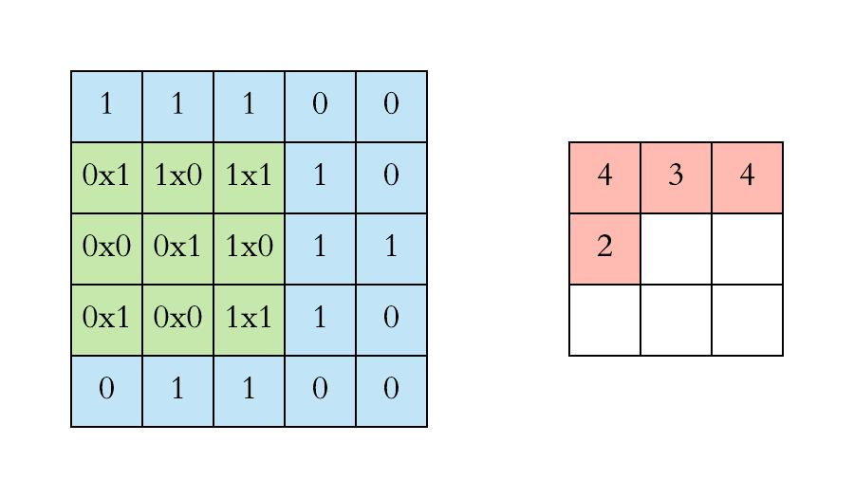
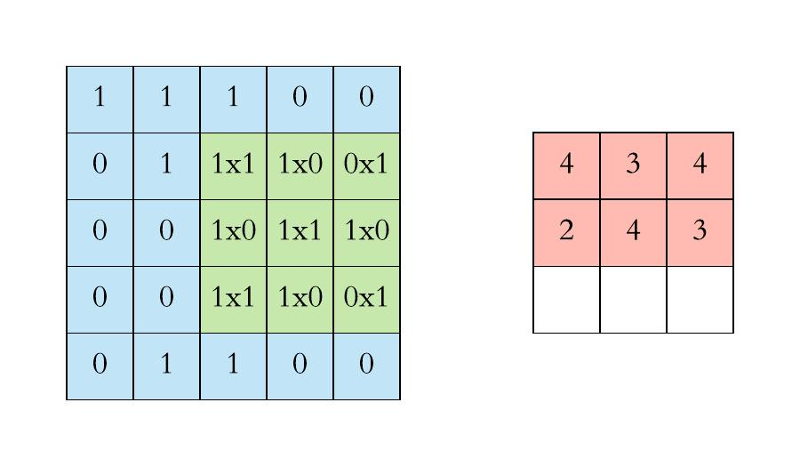
Convolution Operation
image source[6]

Slide 12
Pooling Operation
Pooling operation reduce the size of feature map
Faster training
Pooling gives CNN the caliber of translational invariant response. This is important when we want to detect a pattern in spite of it’s position in input.

Slide 13
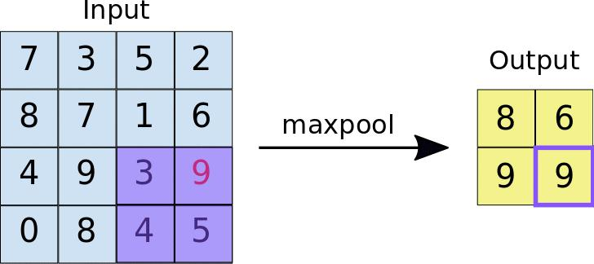
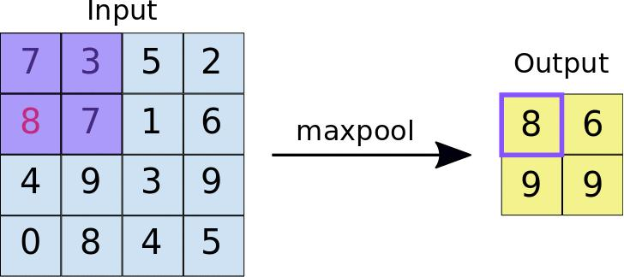
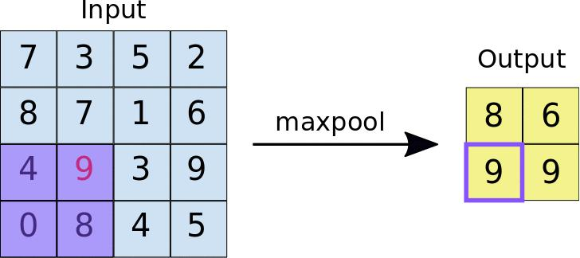
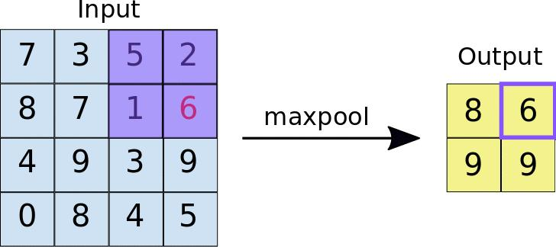
Pooling Operation
image source[7]

Slide 14
Demonstration of Convolution and Pooling
Following Link has some animated demonstration of convolution operation with different strides and paddings
https://github.com/vdumoulin/conv_arithmetic

Slide 15
Counting Learnable Parameter in CNN
From the operation uniquely used by CNN, only convolution operation is the source of learnable parameter. Pooling layer has no learnable parameter
Usually, a fully connected deep neural network is added after the convolution and pooling layer. So, learnable parameters of CNN = # of parameter from convolution + # of fully connected layer (MLP) parameter
A convolution operation is modeled by single neuron. So, # o parameters of the convolution layer = # of weights and biases in the neuron.

Slide 16
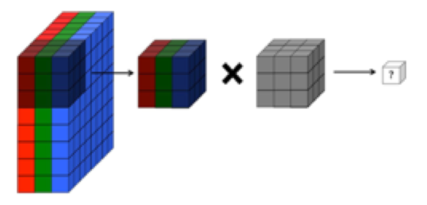
Counting Learnable Parameter in CNN
Convolution Neuron for an RGB image[3]
image source[8]
Here the convolutional filter/kernel works with 3x3x3 pixels of image.
If we think this kernel as a neuron then each cell’s value in kernel can be thought as weight for the neuron.
This same neuron is repeatedly applied for whole image and it produces one feature map.
If a convolution layer has 6 neuron then it will give 6 feature map. So, output will be 6 channeled.
# of parameter for conv. layer = # of neuron*( (kernel dim*kernel dim * input channel)+1)
Here if # of neuron = 5. Then # of parameter = 5 * (3*3*3 + 1) = 140

Slide 17
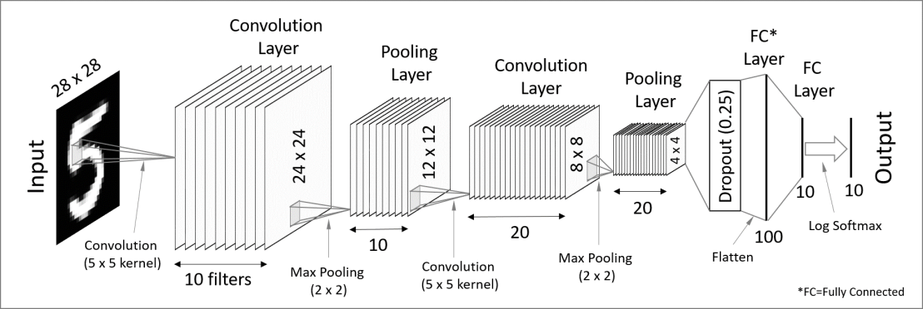
Counting Learnable Parameter in CNN
Example CNN
image source[9]

Slide 18
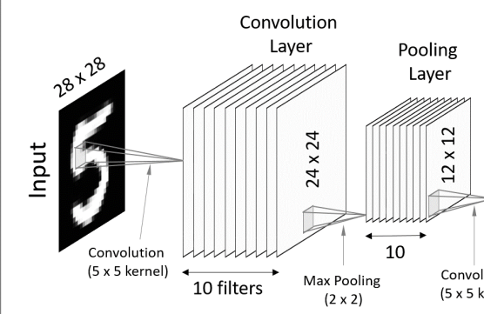
Counting Learnable Parameter in CNN
Example CNN
image source[9]
# of parameter in First convolution layer = # of output channel*(# of input channel*kernel dim*kernel dim + 1) = 10*(1*5*5+1) = 260
Pooling Layer has no learnable paramter. Reduce feature map size to 12x12. Output size from 24x24x10 to 12x12x10
# of parameter = 260

Slide 19
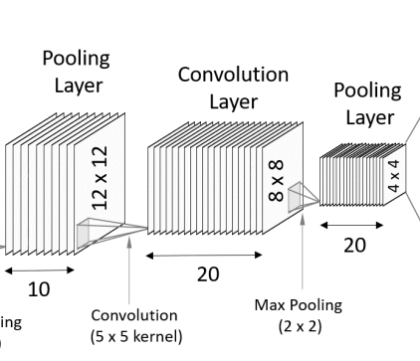
Counting Learnable Parameter in CNN
Example CNN
image source[9]
# of parameter in First convolution layer = # of output channel*(# of input channel*kernel dim*kernel dim + 1) = 20*(10*5*5+1) = 5020
Pooling Layer has no learnable paramter. Reduce feature map size to 4x4. Output size from 8x8x20 to 4x4x20
# of parameter = 260+5020 = 5280

Slide 20
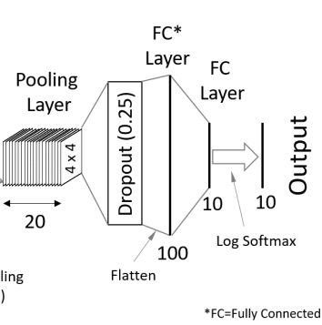
Counting Learnable Parameter in CNN
Example CNN
image source[9]
all 320 cells of 4x4x20(=320) is used as input for fully connected layer.
Dropout layer has no parameter.
From FC layer, first layer has 100 neuron. So, # of paramter = 100*(320+1) = 32100
2nd FC layer has 100 input to 10 neuron. So, # of parameter = 10*(100+1) = 1010
# of parameter = (260+5020) + 32100 + 1010 = 5280 + 32100 + 1010 = 38390
Therefore, # of parameter = 38390

Slide 21
Thank You

Slide 22
References & Acknowledgements
References :
https://www.deeplearningbook.org/
https://github.com/vdumoulin/conv_arithmetic
https://towardsdatascience.com/understanding-and-calculating-the-number-of-parameters-in-convolution-neural-networks-cnns-fc88790d530d
https://ai.stackexchange.com/questions/5769/in-a-cnn-does-each-new-filter-have-different-weights-for-each-input-channel-or
Image sources :
https://download.acti.com/corpweb/DownloadCenter/Ajax/MakeThumbImage.ashx?id=18081&maxWidth=400&toext=png
https://www.arunponnusamy.com/images/yolo-object-detection-opencv-python/yolo-object-detection.jpg
https://adeshpande3.github.io/assets/Cover.png
https://cdn-images-1.medium.com/max/2400/1*vkQ0hXDaQv57sALXAJquxA.jpeg
https://nicholastsmith.files.wordpress.com/2017/04/cnnanim.gif?w=1100
https://cdn-images-1.medium.com/max/1600/1*VVvdh-BUKFh2pwDD0kPeRA@2x.gif
https://developers.google.com/machine-learning/practica/image-classification/images/maxpool_animation.gif
https://ai.stackexchange.com/questions/5769/in-a-cnn-does-each-new-filter-have-different-weights-for-each-input-channel-or
https://codetolight.files.wordpress.com/2017/11/network.png?w=1108

